Slide 1
Become an oauth2 provider using spring security
Presented by : Mayank Sharma
Release Manager, Dev Tools Manager @ OpenMRS

Slide 2
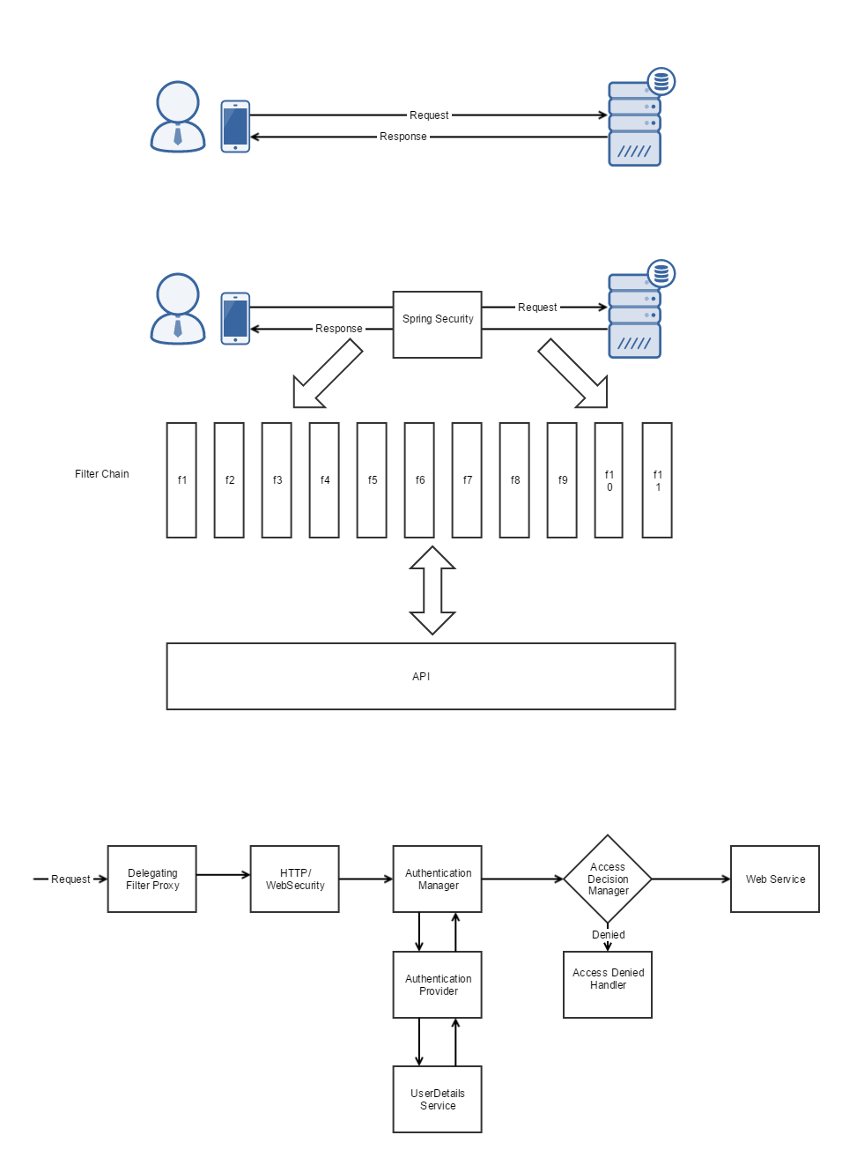
Spring security can help implement :
CAS – Central Authentication Service
JAAS – Java Authorization and Authentication Service
OAuth2 Authorization Server
CSRF attack detection/ protection against it.
OpenID
LDAP and so on…….

Slide 3
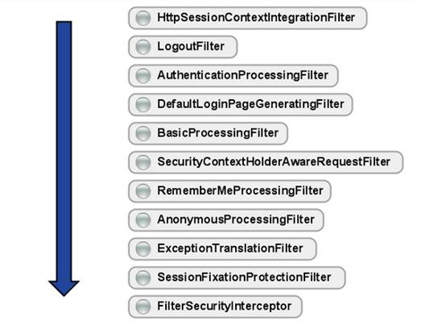
Spring security is a filter chain supported by an API

Slide 4
Spring Security – Flow and config

Slide 5
Spring Security OAuth2
Authorization Server Configurations :
ClientDetailsServiceCoonfigurer (UserDetailsService)
AuthorizationFrameworkTokenServices
Grant Types
Authorization and Token Endpoint (Http/ Web Security)’
Resource Server Configurations :
TokenServices
Resource ID

Slide 6
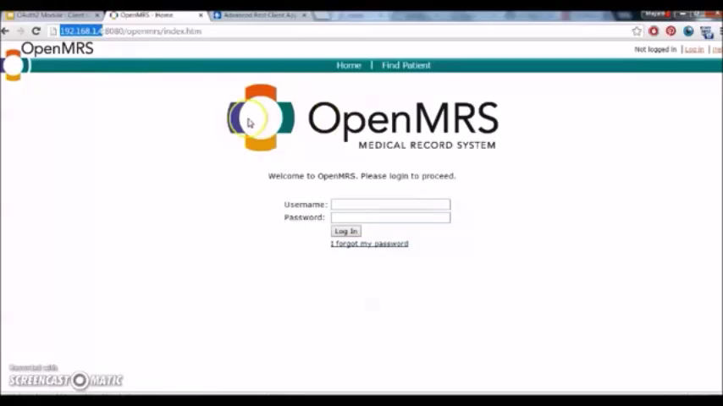
Demo + code

Slide 7
That was quick! Let’s chat more :
Mayank Sharma
Twitter : maany_shr (<- link to slide and demo, code, resources)
GitHub : maany
Email : maany@openmrs.org
LinkedIn : mayanksharma94

